Slide 1
Polynomial Regression
Abhishikta Varma

Slide 2
Introduction
Polynomial Regression is a regression algorithm that models the relationship between a dependent(y) and independent variable(x) as nth degree polynomial of x.
That is, if your dataset holds the characteristic of being curved when plotted in the graph then you should go with polynomial regression instead of Simple or Multi Linear regression models.
It is also called the special case of Multiple Linear Regression in ML. Because we add some polynomial terms to the Multiple Linear regression equation to convert it into Polynomial Regression.
The dataset used in Polynomial regression for training is of non-linear nature.
It makes use of a linear regression model to fit the complicated and non-linear functions and datasets.
Hence, "In Polynomial regression, the original features are converted into Polynomial features of required degree (2,3,..,n) and then modeled using a linear model."

Slide 3
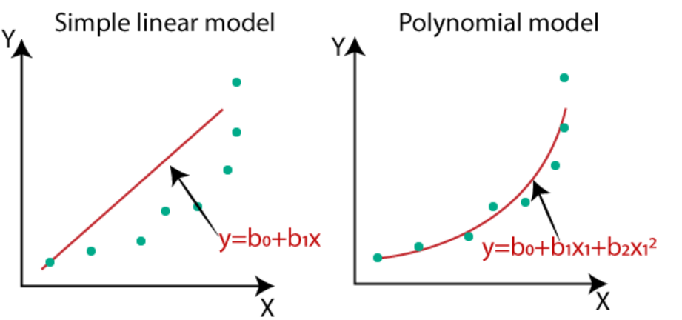
Why we need Polynomial Regression.
If we apply a linear model on a linear dataset, then it provides us a good result as we have seen in Simple Linear Regression, but if we apply the same model without any modification on a non-linear dataset, then it will produce a drastic output. Due to which loss function will increase, the error rate will be high, and accuracy will be decreased.
So for such cases, where data points are arranged in a non-linear fashion, we need the Polynomial Regression model. We can understand it in a better way using the below comparison diagram of the linear dataset and non-linear dataset.

Slide 4
In the above image, we have taken a dataset which is arranged non-linearly. So if we try to cover it with a linear model, then we can clearly see that it hardly covers any data point. On the other hand, a curve is suitable to cover most of the data points, which is of the Polynomial model.
Hence, if the datasets are arranged in a non-linear fashion, then we should use the Polynomial Regression model instead of Simple Linear Regression.
A Polynomial Regression algorithm is also called Polynomial Linear Regression because it does not depend on the variables, instead, it depends on the coefficients, which are arranged in a linear fashion.

Slide 5
Equation of the Polynomial Regression Model:
Simple Linear Regression equation: y = b₀+b₁x
Multiple Linear Regression equation: y= b₀+b₁x+ b₂x₂+ b₃x₃+....+ b_{n}x_{n}
Polynomial Regression equation: y= b₀+b₁x + b₂x²+ b₃x³+....+ b_{n}x^{n}
When we compare the above three equations, we can clearly see that all three equations are Polynomial equations but differ by the degree of variables. The Simple and Multiple Linear equations are also Polynomial equations with a single degree, and the Polynomial regression equation is Linear equation with the nth degree. So if we add a degree to our linear equations, then it will be converted into Polynomial Linear equations.
Here y is the dependent variable, x is the independent variable, b0, b1, b2, ..., bn are the coefficients of the model, and n is the degree of the polynomial.

Slide 6
To find the values of the coefficients b0, b1, b2, ..., bn, we need to minimize the sum of squared errors (SSE) between the predicted values of y and the actual values of y in the training data. This can be done using the method of least squares.
The method of least squares involves finding the values of b0, b1, b2, ..., bn that minimize the sum of squared errors:
SSE = ∑(yi - y^i)^2
where yi is the actual value of the dependent variable, y^i is the predicted value of the dependent variable, and the summation is over all the data points in the training data.
To minimize the SSE, we take the derivative of SSE with respect to each coefficient bi and set it equal to zero:
∂SSE/∂bi = 0
Solving these equations simultaneously gives us the values of b0, b1, b2, ..., bn that minimize the SSE and hence give us the best-fitting polynomial regression model.

Slide 7
Algorithm for Polynomial Regression:
Import the necessary libraries: NumPy and scikit-learn
Load the dataset: Load the dataset that you want to perform polynomial regression on.
Split the dataset: Split the dataset into training and testing sets.
Create the polynomial features: Create the polynomial features of the independent variable x by using the scikit-learn PolynomialFeatures class.
Fit the linear regression model: Fit the linear regression model on the polynomial features of the independent variable x and the dependent variable y.
Predict the values: Use the linear regression model to predict the values for the testing set.
Evaluate the model: Evaluate the performance of the model using metrics such as mean squared error, root mean squared error, and R-squared

Slide 8
Examples for Polynomial Regression:
Some examples for polynomial regression model
Predicting housing prices: A dataset of housing prices with features like square footage, number of bedrooms, and number of bathrooms can be used to predict the housing prices using polynomial regression. By fitting a polynomial curve to the data, you can get a better estimate of the housing prices based on the given features.
Forecasting sales revenue: A dataset of sales revenue with features like time, seasonality, and marketing spend can be used to forecast future sales using polynomial regression. By fitting a polynomial curve to the data, you can estimate how the sales revenue will change over time based on the given features.
Predicting stock prices: A dataset of stock prices with features like company financials, market trends, and news sentiment can be used to predict the stock prices using polynomial regression. By fitting a polynomial curve to the data, you can get a better estimate of the stock prices based on the given features.

Slide 9
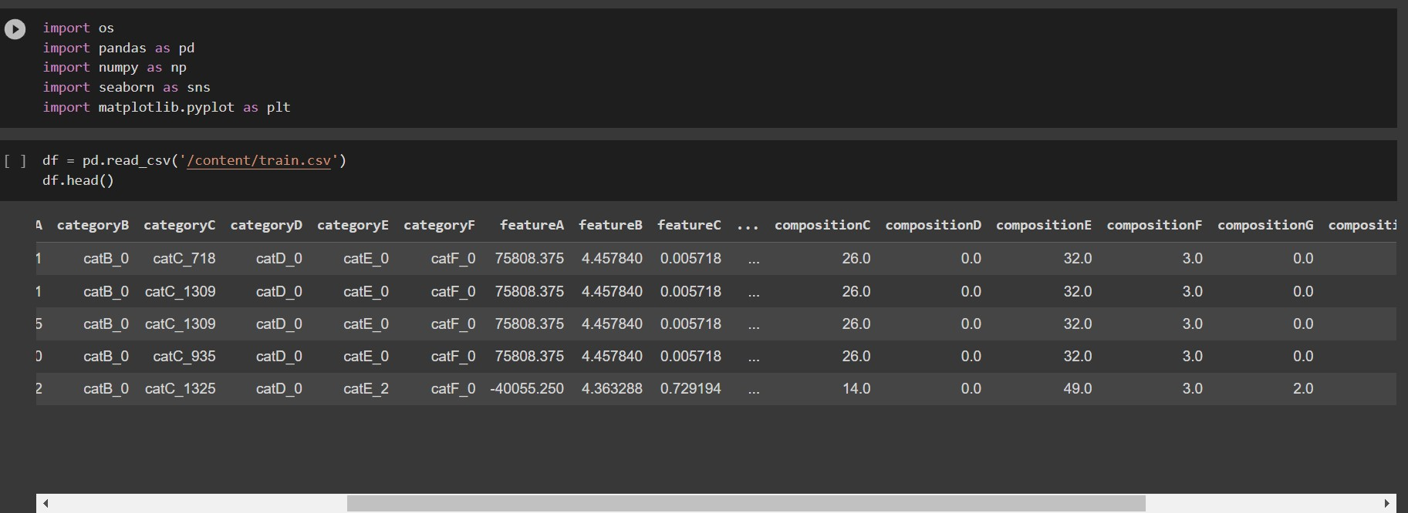
Implementation of Polynomial Regression Model:
PROBLEM STATEMENT:
A growing number of factors, including pollution, population expansion, and climate change, are putting the world's water resources in danger. How to obtain enough water to satisfy human demands while also conserving the integrity of aquatic ecosystems is a recurring concern as the world's population rises. The Pacific Institute works on global water resource issues in partnership with stakeholders to make sure that people and nature have access to the water they require to survive today and in the future. Our aim is to train a machine learning model based on the water quality data provided to you in the training file and further predict the quality estimation result for the test dataset.

Slide 10
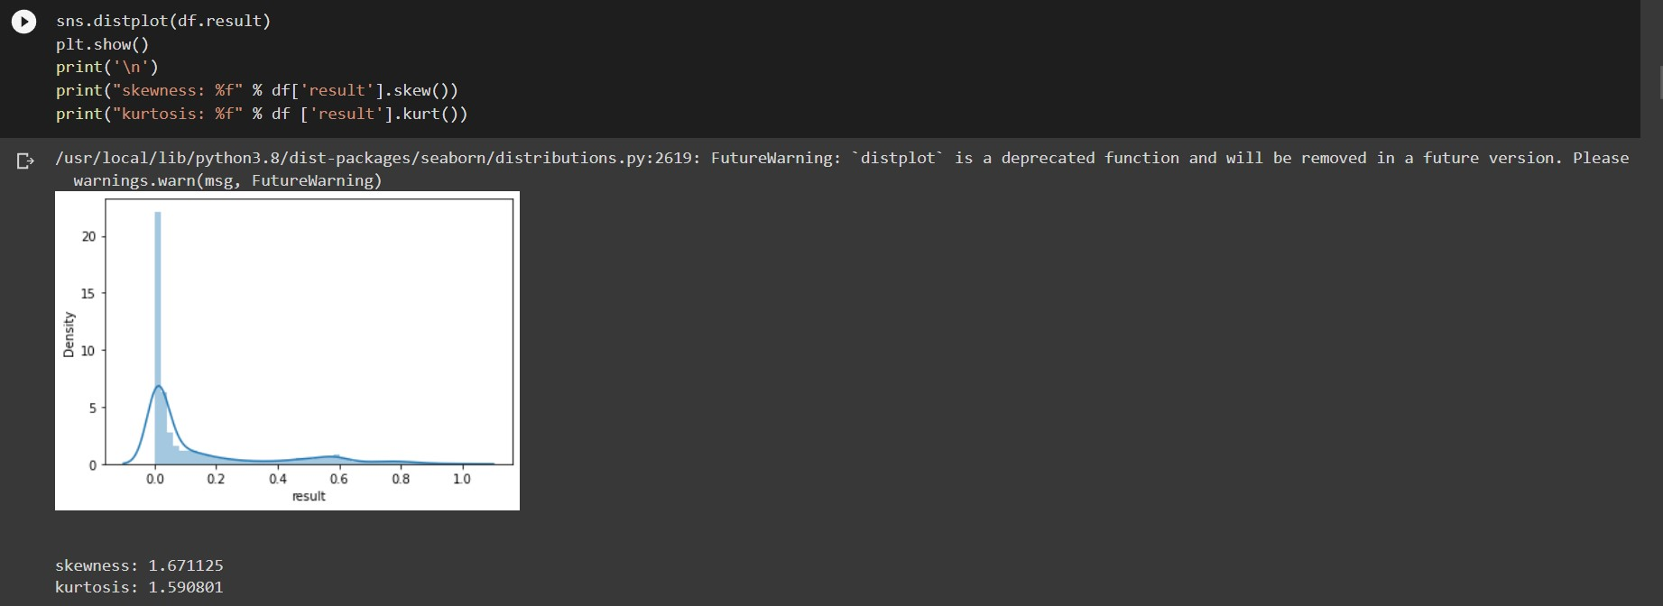
Plotting graph to know about skewness of data
We got skewness 1.671125
Which means the data is right skeweed

Slide 11
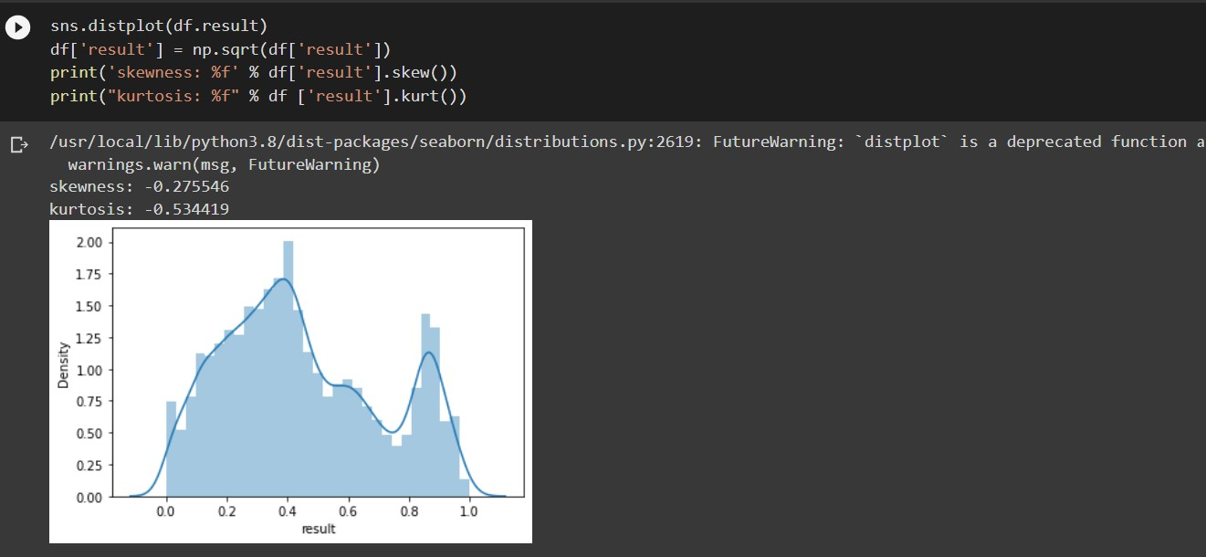
Without knowing the specific value of skewness, it's difficult to determine the nature of the distribution. However, if the skewness is between -1 and 1, the distribution is generally considered to be approximately symmetrical or unskewed. This means that the majority of the data falls near the mean, and there are no significant outliers causing the distribution to be skewed in one direction or the other.

Slide 12
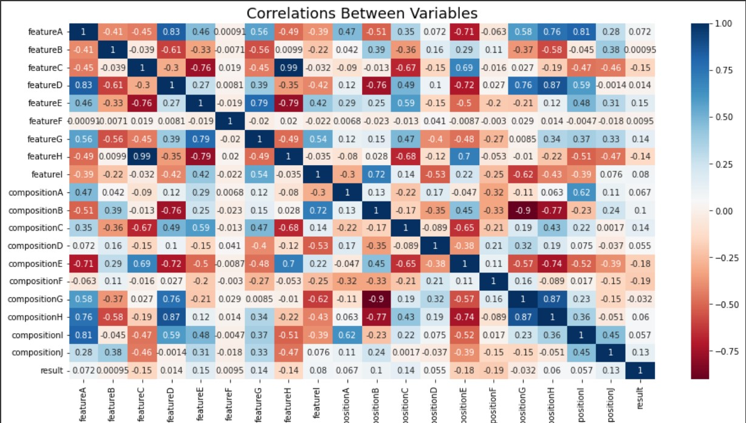
Plotting Heat Map in order to see Correlation between Variables, here the correlation between with the column is one which means highly correlated.
The region which is in red is said to be negative correlated and the region which is blue is positive correlation

Slide 13
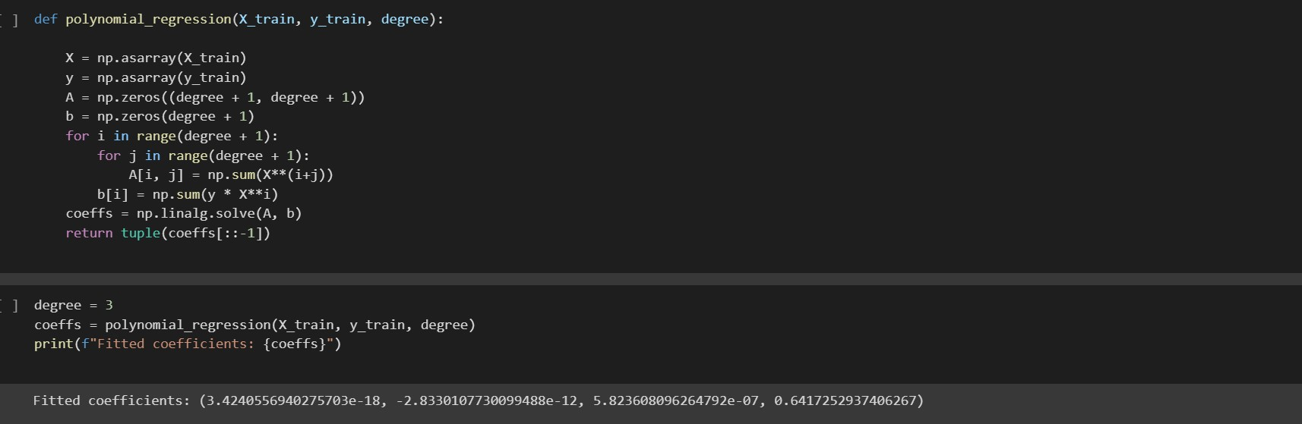
This function uses the method of least squares to fit a polynomial of the specified degree to the input data. The coefficients of the fitted polynomial are returned in descending order of degree.
Now let's use this function to fit a polynomial of degree 3 to our synthetic data:

Slide 14
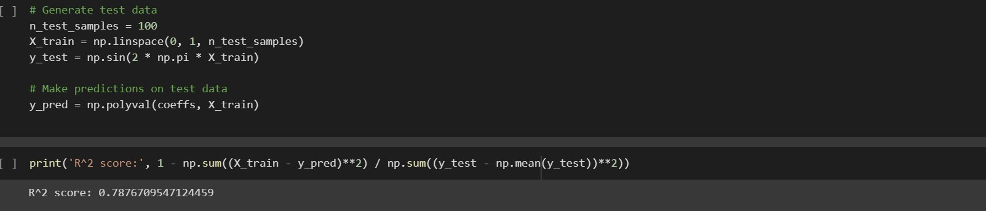
Finally, we can use these coefficients to make predictions on test data. Let's generate some test data and plot the fitted polynomial along with the original data.
An R2 score of 0.7876709547124459 indicates that the regression model explains 78.77% of the variance in the target variable. This means that the model fits the data reasonably well, but there is still some unexplained variability in the target variable that the model is unable to capture

Slide 15
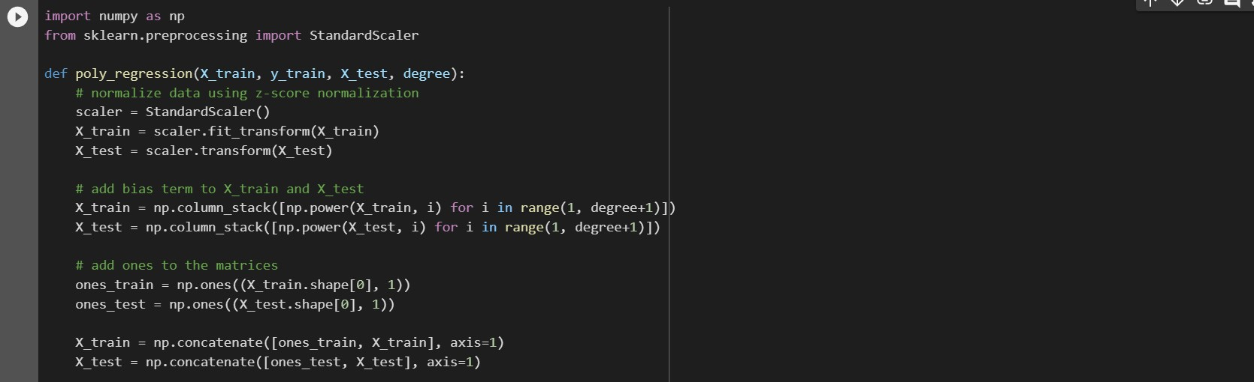
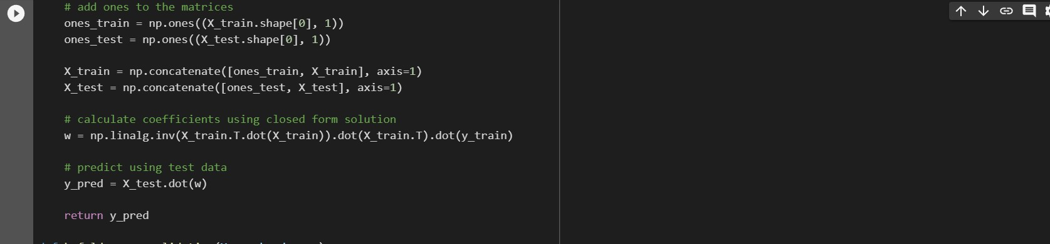
Cross -Validation

Slide 16
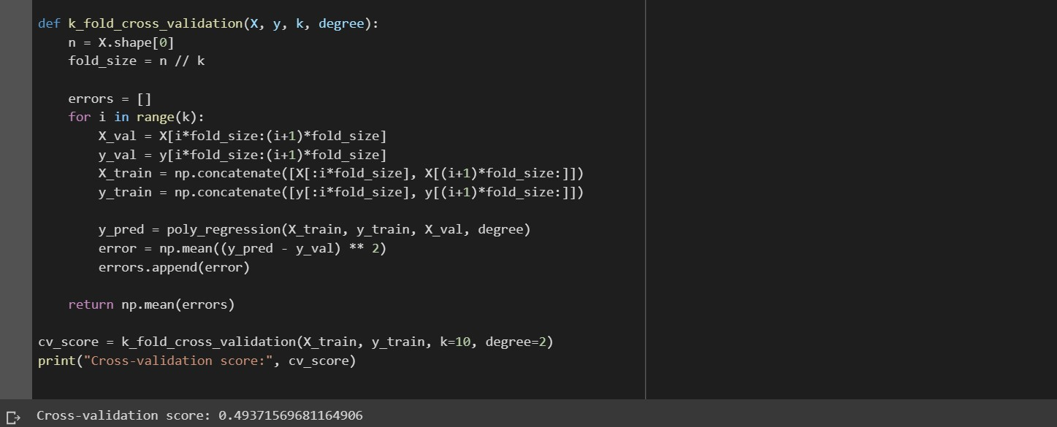
The cross-validation score of 0.49371569681164906 means that the mean squared error of the model is 0.4937 on average across all the folds in the k-fold cross-validation process. This indicates that the model is performing well on the data, with lower values of mean squared error indicating better performance. However, it's important to keep in mind that the performance of the model on the test data could still be different and should be evaluated separately.

Slide 17
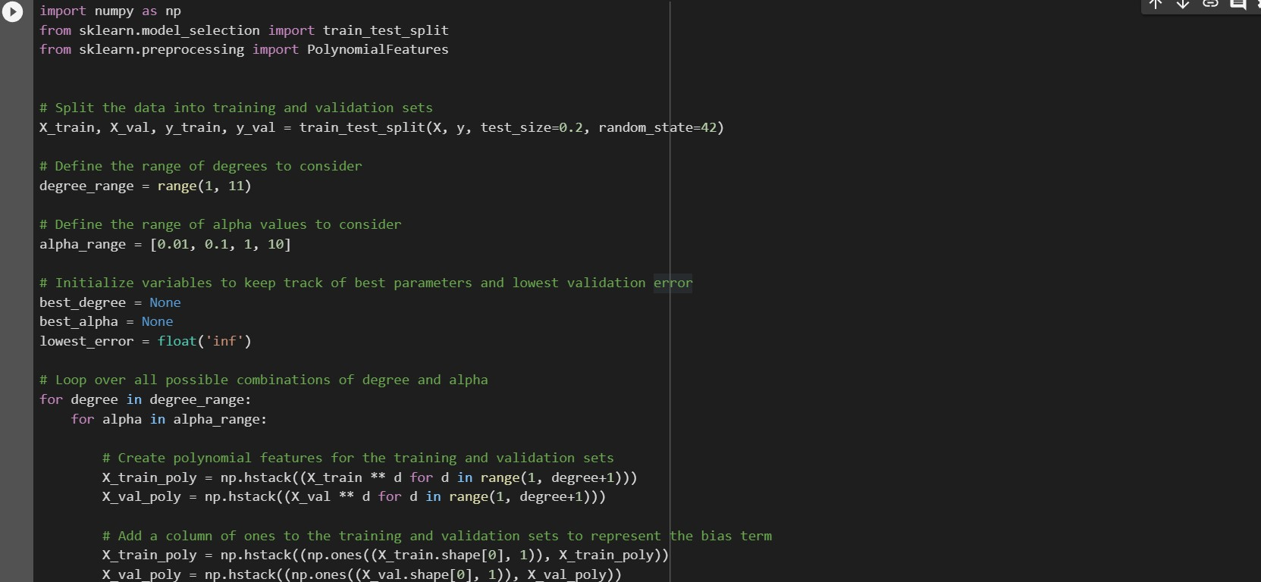

Slide 18
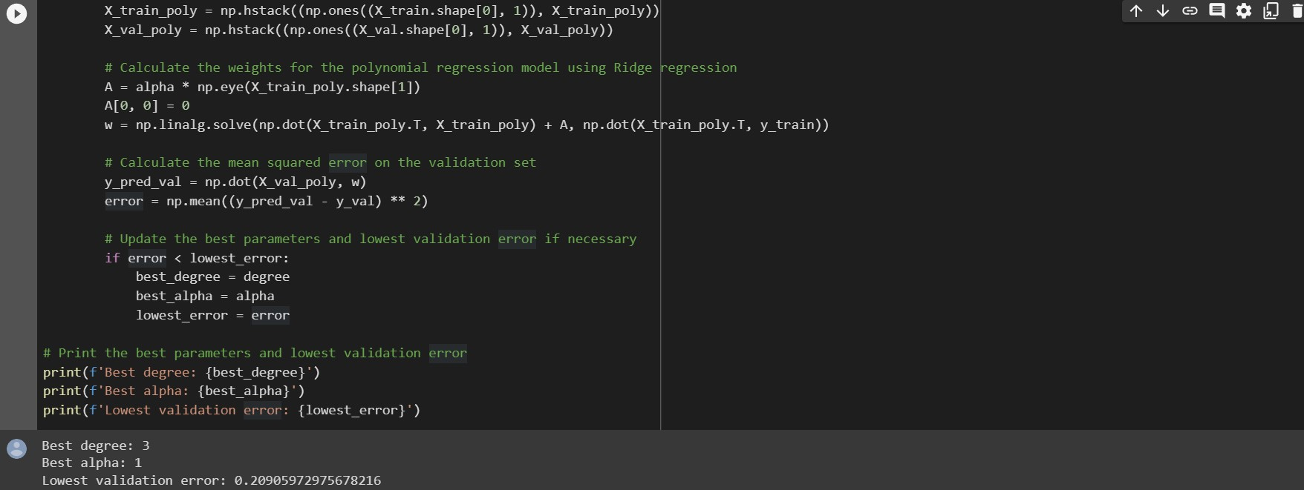
We got the best parameters those are degree 3 and alpha 1, and lowest error 0.29

Slide 19
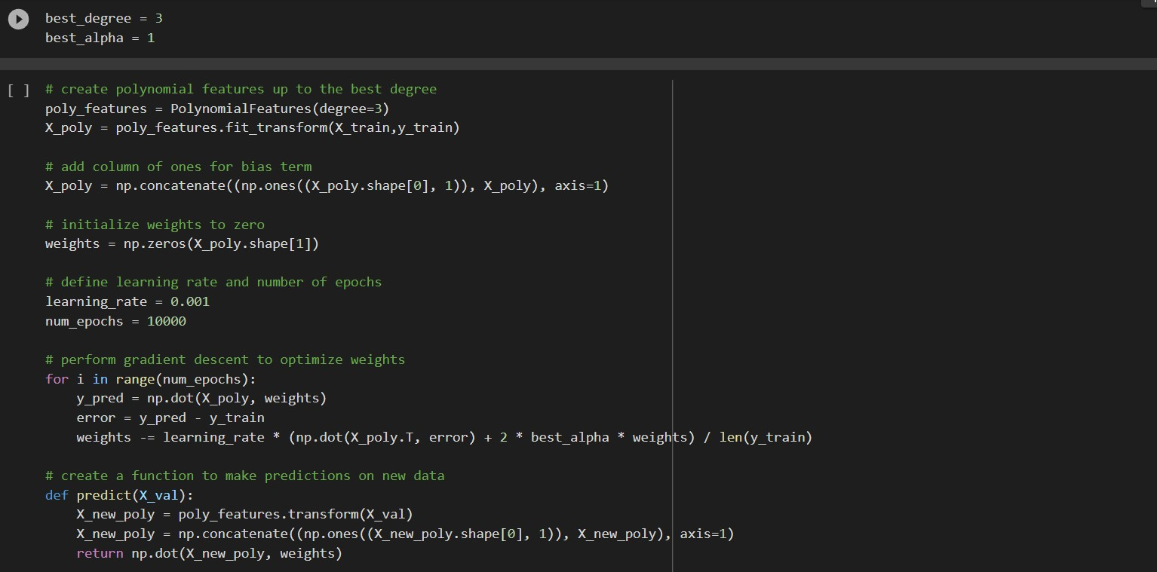

Slide 20
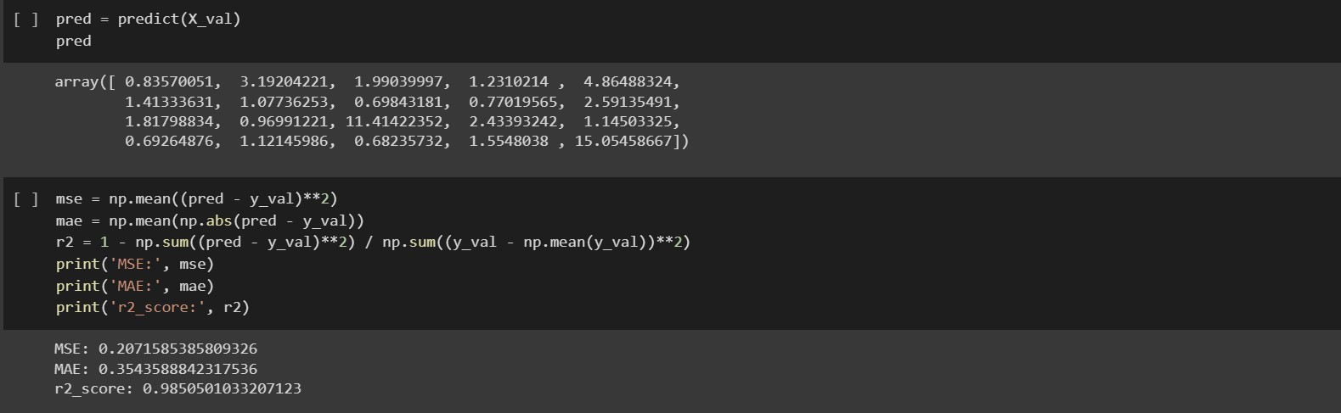
We got MSE: 0.2071585385809326 MAE: 0.3543588842317536 r2_score: 0.9850501033207123

Slide 21
Conclusion
An R2 score of 0.7876709547124459 indicates that the regression model explains 78.77% of the variance in the target variable. This means that the model fits the data reasonably well, but there is still some unexplained variability in the target variable that the model is unable to capture.
In general, a higher R2 score indicates a better fit of the regression model to the data. However, it is important to keep in mind that a high R2 score does not necessarily mean that the model is a good predictor of the target variable. It is also important to evaluate other metrics and consider other factors, such as the complexity of the model and the interpretability of the results, when assessing the quality of a regression model
After using Cross validation we got accuracy 49%
After using hyper parameter tuning we got accuracy 98%

Slide 22
References:
https://www.kaggle.com/code/tracyporter/water-quality/data
https://www.kaggle.com/code/tracyporter/water-quality/input?select=train.csv
https://www.kaggle.com/code/tracyporter/water-quality/input?select=test.csv
https://chat.openai.com/chat

Slide 23
Thank You

